Slide 1
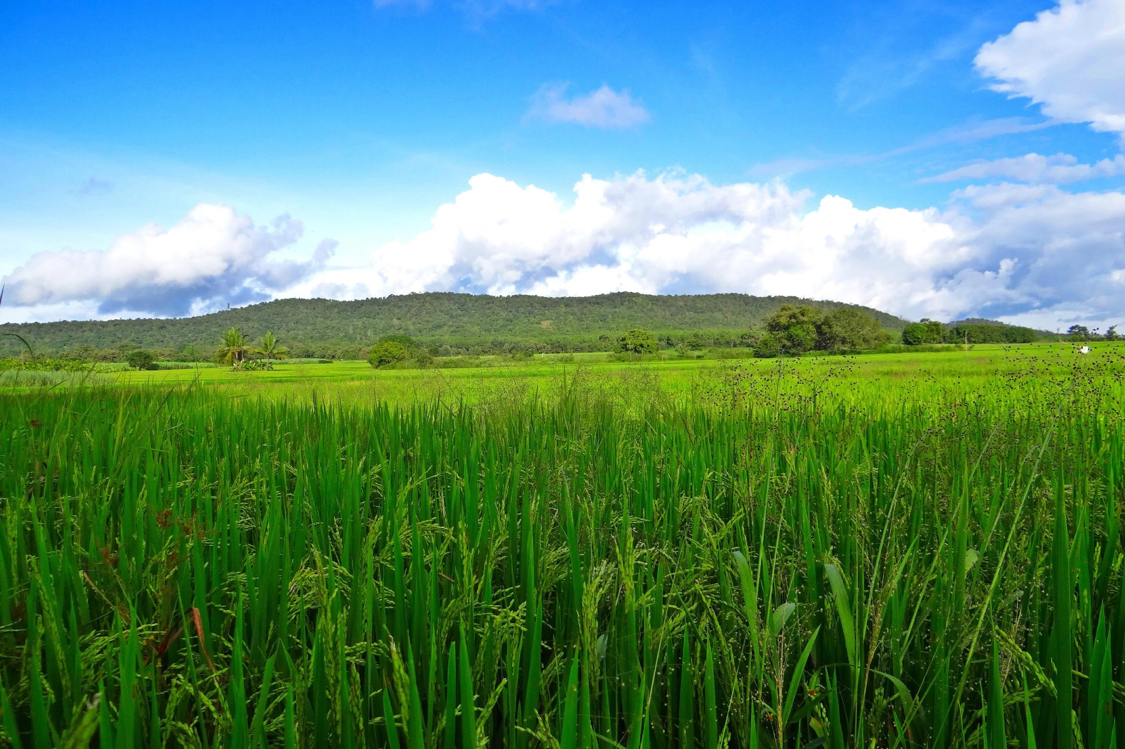
SMART AGRICULTURE SOLUTION
DIVYA SRI DHARSHINI B (SIT23CS043)
SHARMILA J (SIT23CS037)
NIRANJANA N (SIT23CS057))
SRI SAIRAM INSTITUTE OF TECHNOLOGY

Slide 2
INTRODUCTION
Smart agriculture integrates technology into traditional farming practices.
Data collected helps farmers make informed decisions about irrigation, fertilization, and pest control.
Smart agriculture aims to increase yields, reduce resource consumption, and enhance sustainability.

Slide 3
PROBLEMS IN AGRICULTURE
Climatic change: Climatic change causes erratic weather patterns, extreme temperatures, and changes in natural resources.
Loss of agricultural land: Low-yield lands and youth emigration increased the likelihood of farmers losing their lands to urbanization.
Poor irrigation facilities: In India, irrigation facilities are limited, and the majority of farmers are still dependent on rainfall. Rainfed agriculture accounts for about 51% of the net sown area in our country

Slide 4
Price Volatility: Price volatility can lead to income instability for farmers as sudden drops in prices can reduce their income and profits.
Poor Adoption of Mechanization: Due to small land holdings, small farmers find it difficult to adopt mechanization for agricultural operations and crop production.
Manures, Fertilizers, and Biocides: Indian soils have been used for growing crops over thousands of years without caring for replenishing. This has led to depletion and exhaustion of soils resulting in low productivity.

Slide 5
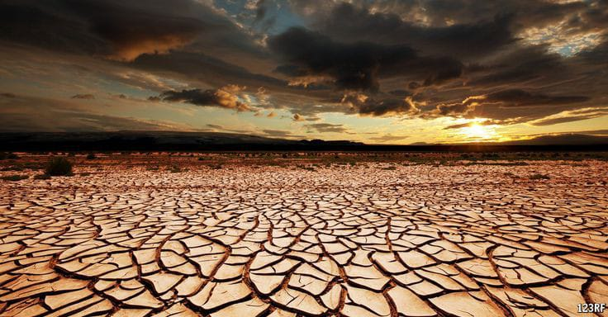
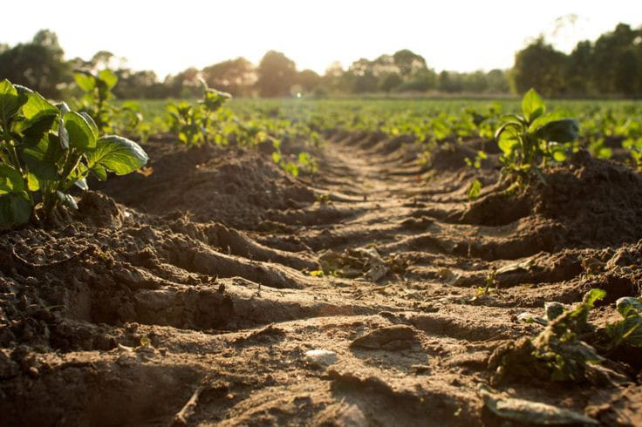
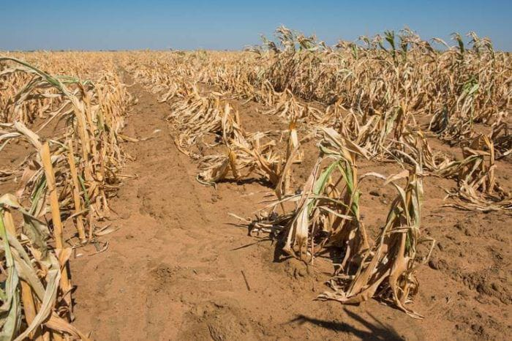
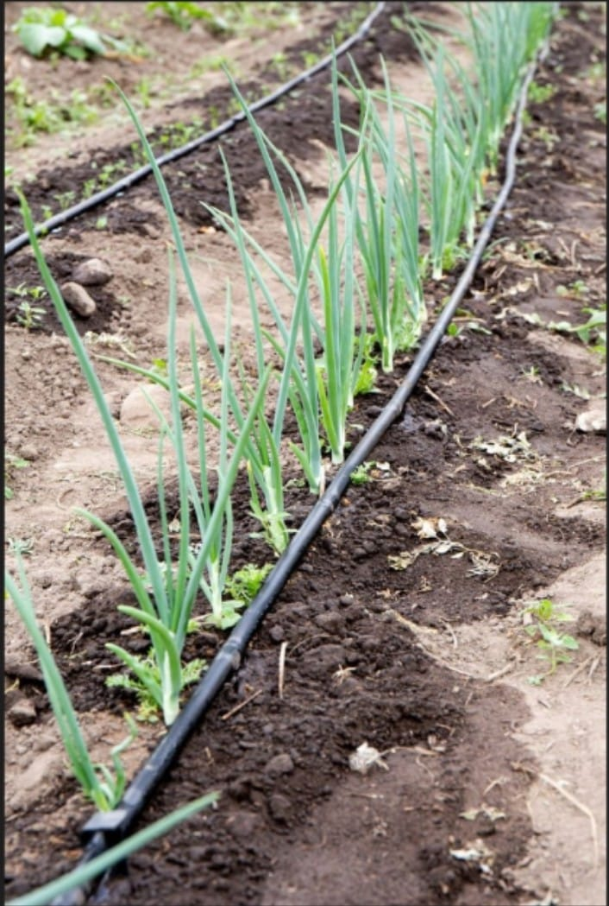
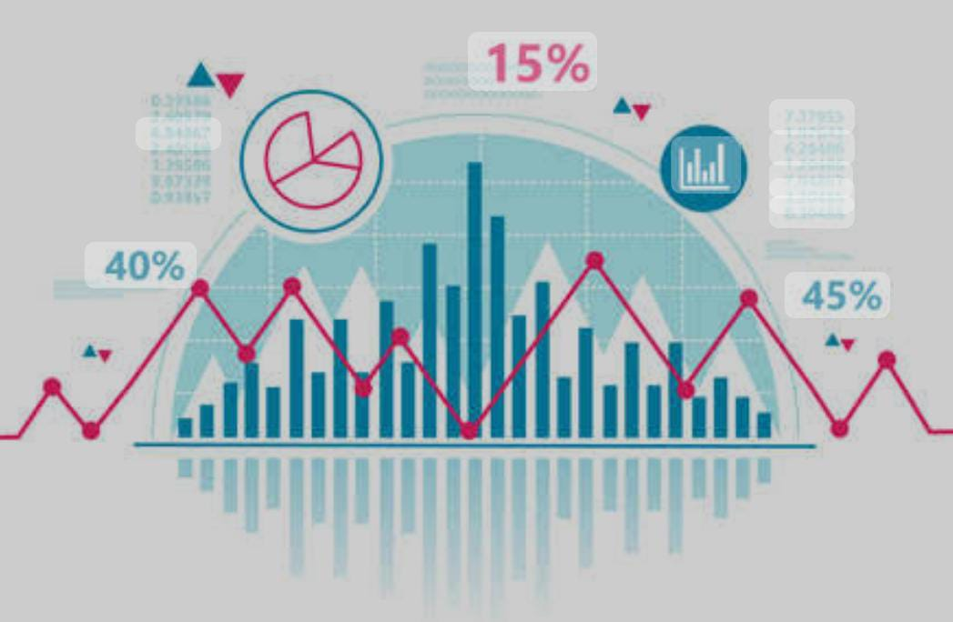
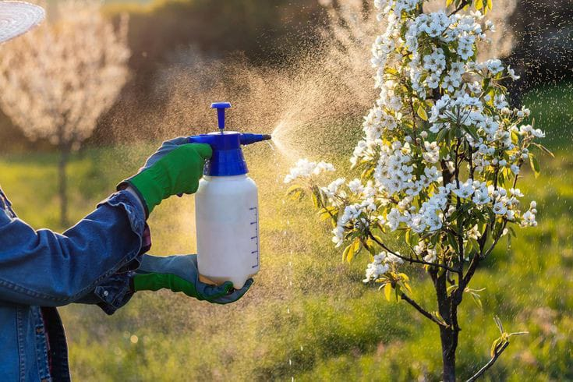
PROBLEM

Slide 6
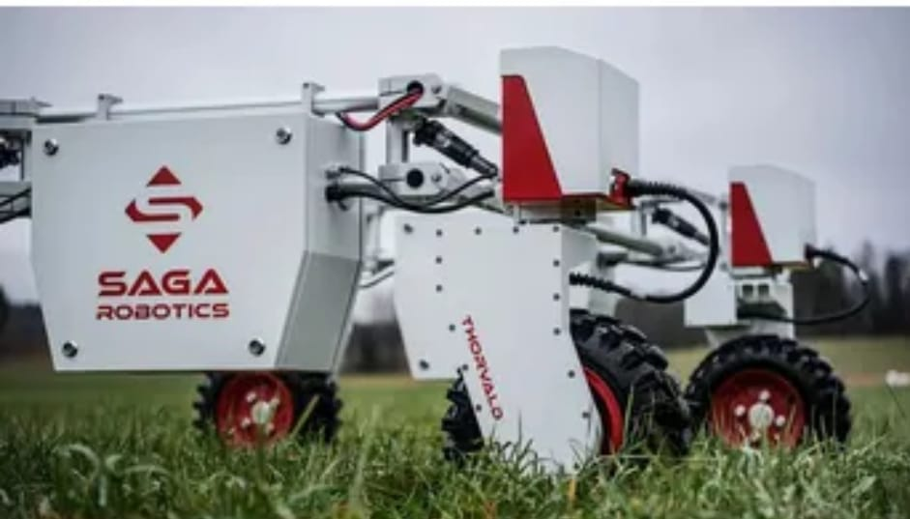
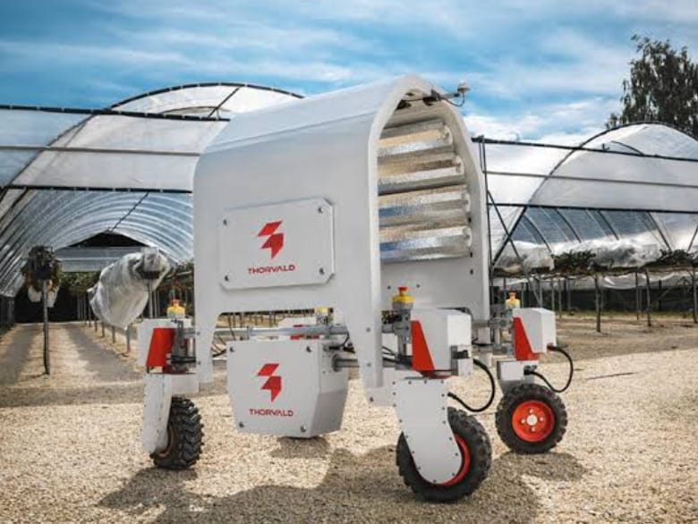
SOLUTIONS
Saga Robotics
Autonomous Harvesting Saga Robotics develops a modular robotic platform called Thorvald, an autonomous farm robot capable of performing several tasks, including harvesting of fruits and vegetables. Farmers can choose from 4 different types of robots based on their specific needs. All their robots use the ROS Software, an open-source meta-operating system for robots.

Slide 7
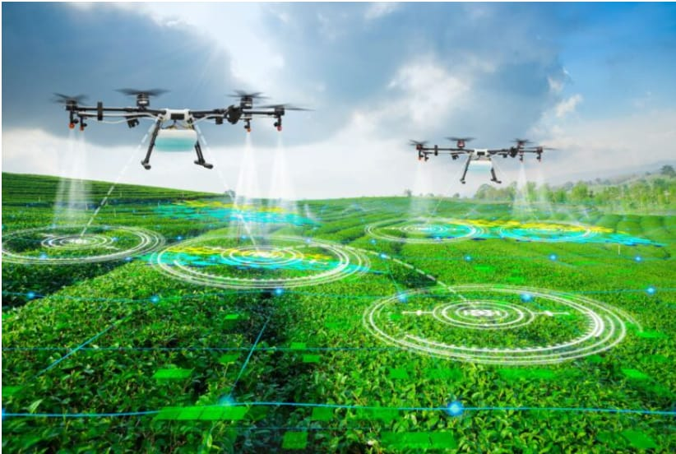
Computer Imaging
Computer imaging involves the use of drones equipped with cameras. They are used for quality control, disease detection, irrigation monitoring, and sorting and grading the produce after harvest. Image processing using machine learning incorporates comparing images from a database with images of standing crops to determine the size, shape, color, and growth, therefore controlling the quality.

Slide 8
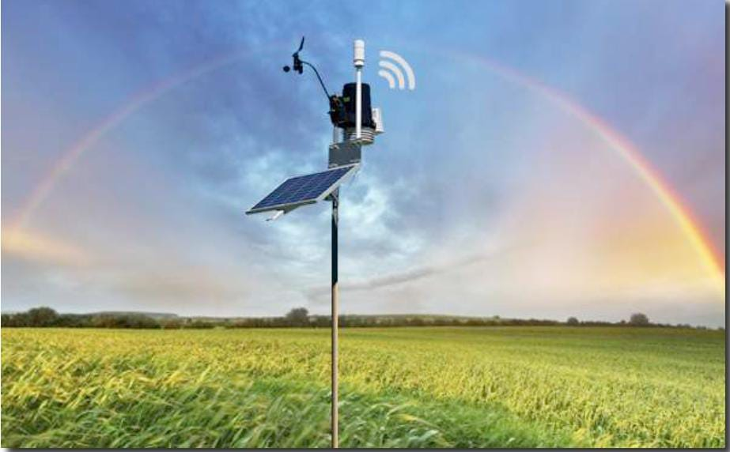
Weather Detection
The solution combines the data from the sensors on the field with live satellite weather forecasting to efficiently plot out suggestions to the farmer that would help him make adjustments to the irrigation or harvesting schedules for his crops.

Slide 9
BENEFITS OF SMART AGRICULTURE
high crop productivity
reduce strain on the environment
precision agriculture
agricultural automation and robotics

Slide 10
CONCLUSION
Smart agriculture holds great promise for the future of farming. Smart agriculture utilizes technology to improve efficiency, productivity, and sustainability in farming practices, leading to increased yields, reduced resource usage, better environmental stewardship and ensuring food security for a growing global population.

Slide 11
REFERENCES:
https://kisanvedika.bighaat.com/news-updates/11-major-problems-faced-by-indian-farmers-in-agriculture-in-2023/
https://www.agrifarming.in/problems-faced-by-indian-farmers-a-full-guide
https://www.ibm.com/topics/smart-farming
https://explicitsuccess.com/agricultural-problems-and-solutions/
https://www.startus-insights.com/innovators-guide/5-top-smart-farming-solutions-impacting-the-agriculture-industry/
https://www.cropin.com/smart-farming
https://www.agrifarming.in/smart-farming-in-india-challanges-techniques-benefits
https://hyscaler.com/insights/empowering-agritec-smart-farming-solutions/

Slide 12
THANK YOU

